Slide 1
Analysis of Citi Bike Usage Patterns
By: Hyunjin Kim

Slide 2
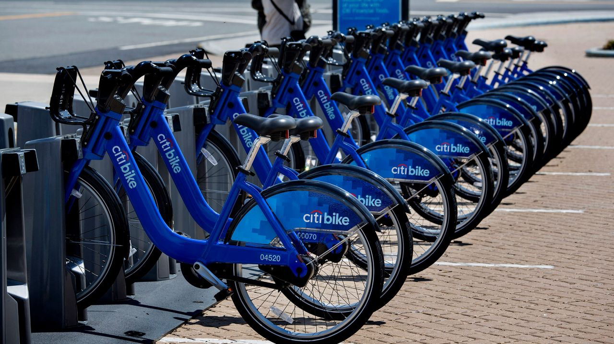
Citi Bike
Are stations that are near parks, waterfront, or recreational areas have longer average ride durations/more rides?

Slide 3
Data overview

Slide 4
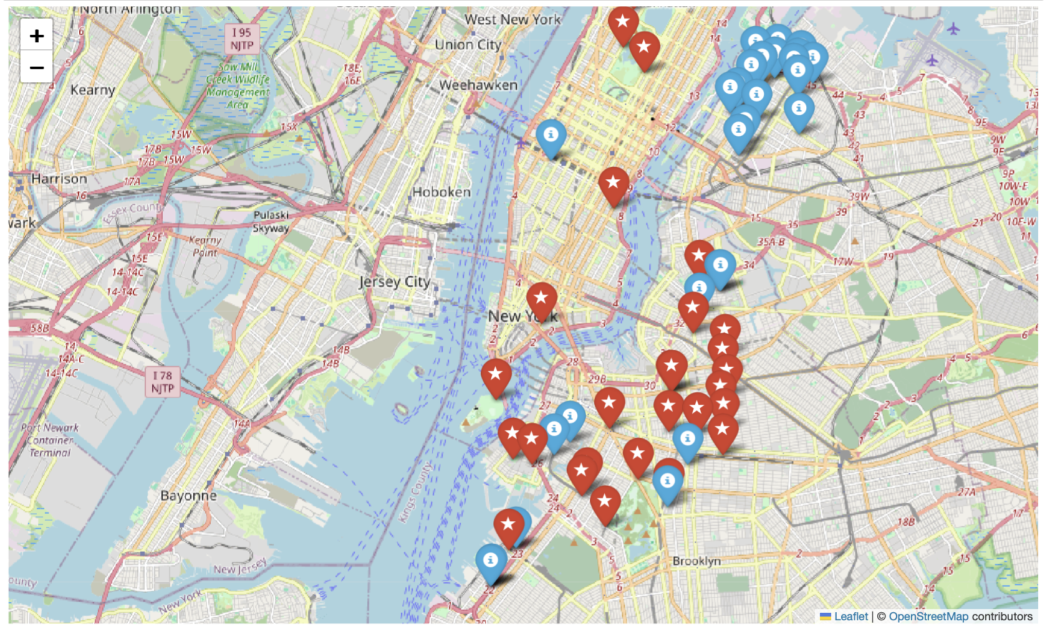
Where are the stations located?
One cluster of stations that are not really used.

Slide 5
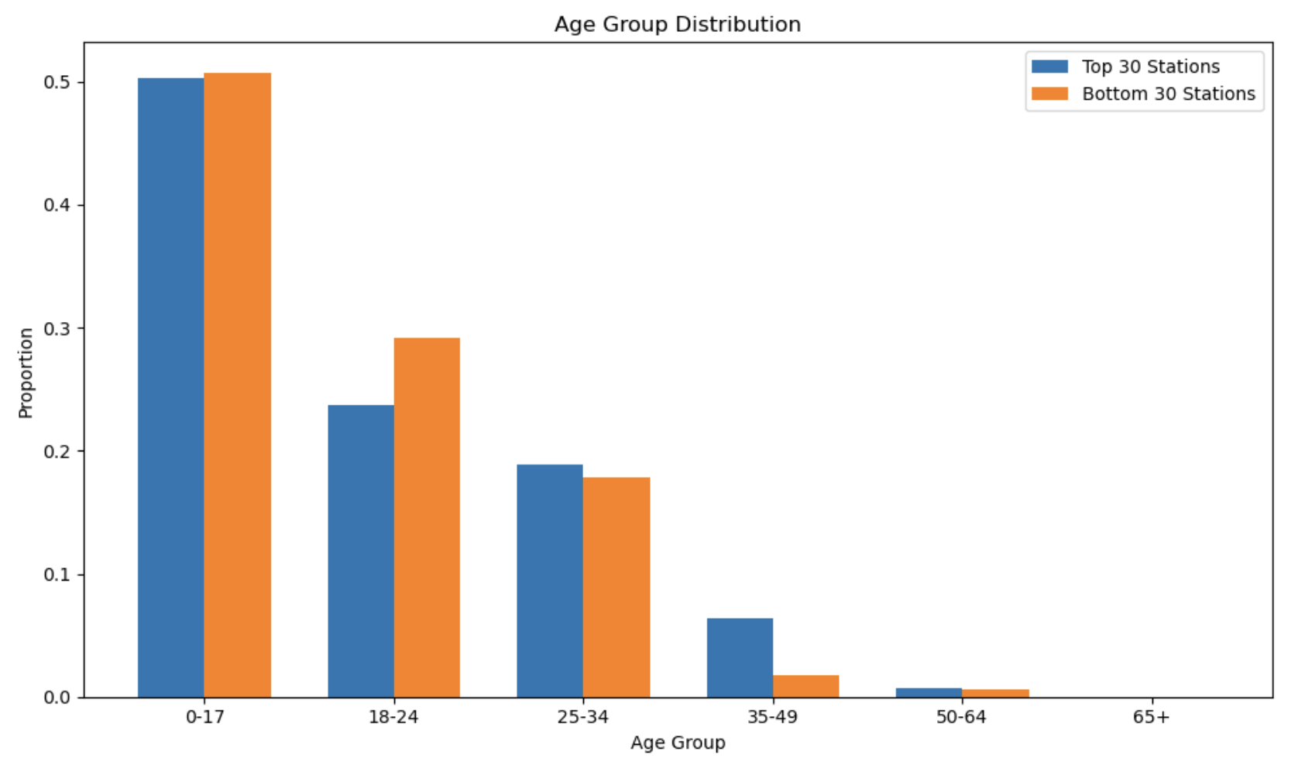
Age Groups?
Is there a specific age group using Citi Bike?

Slide 6
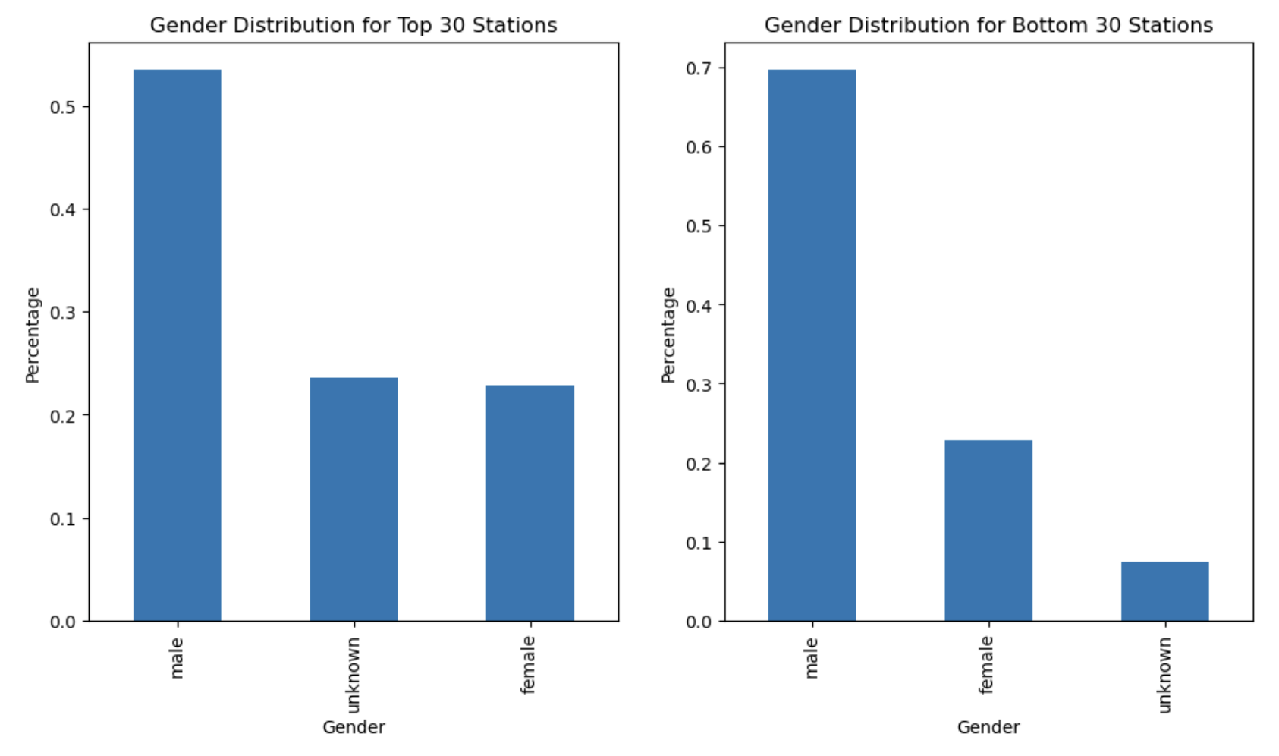
Gender
Does gender play a role in station usage?

Slide 7
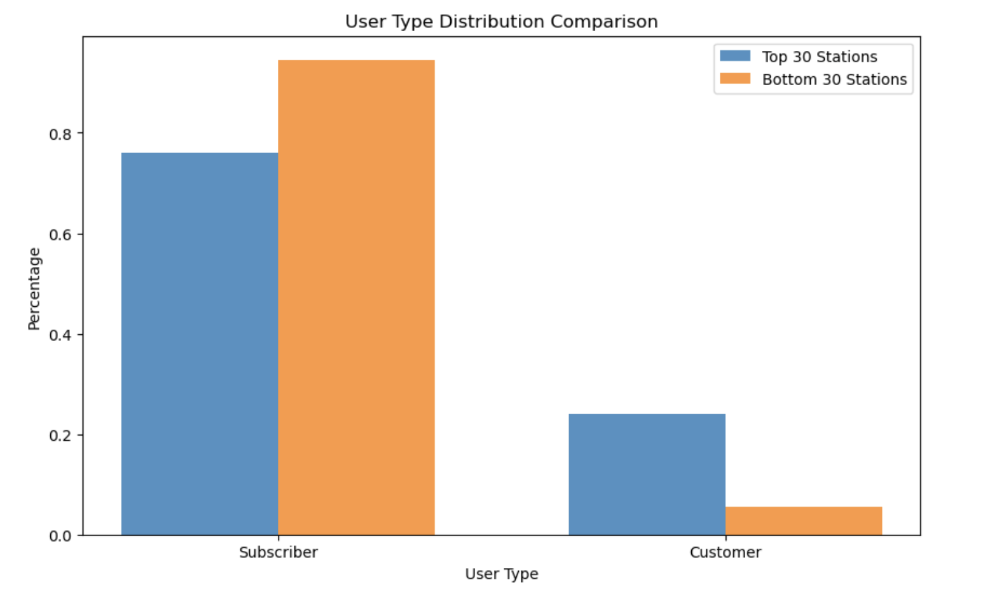
Customer type
Does Customer type affect station usage?

Slide 8
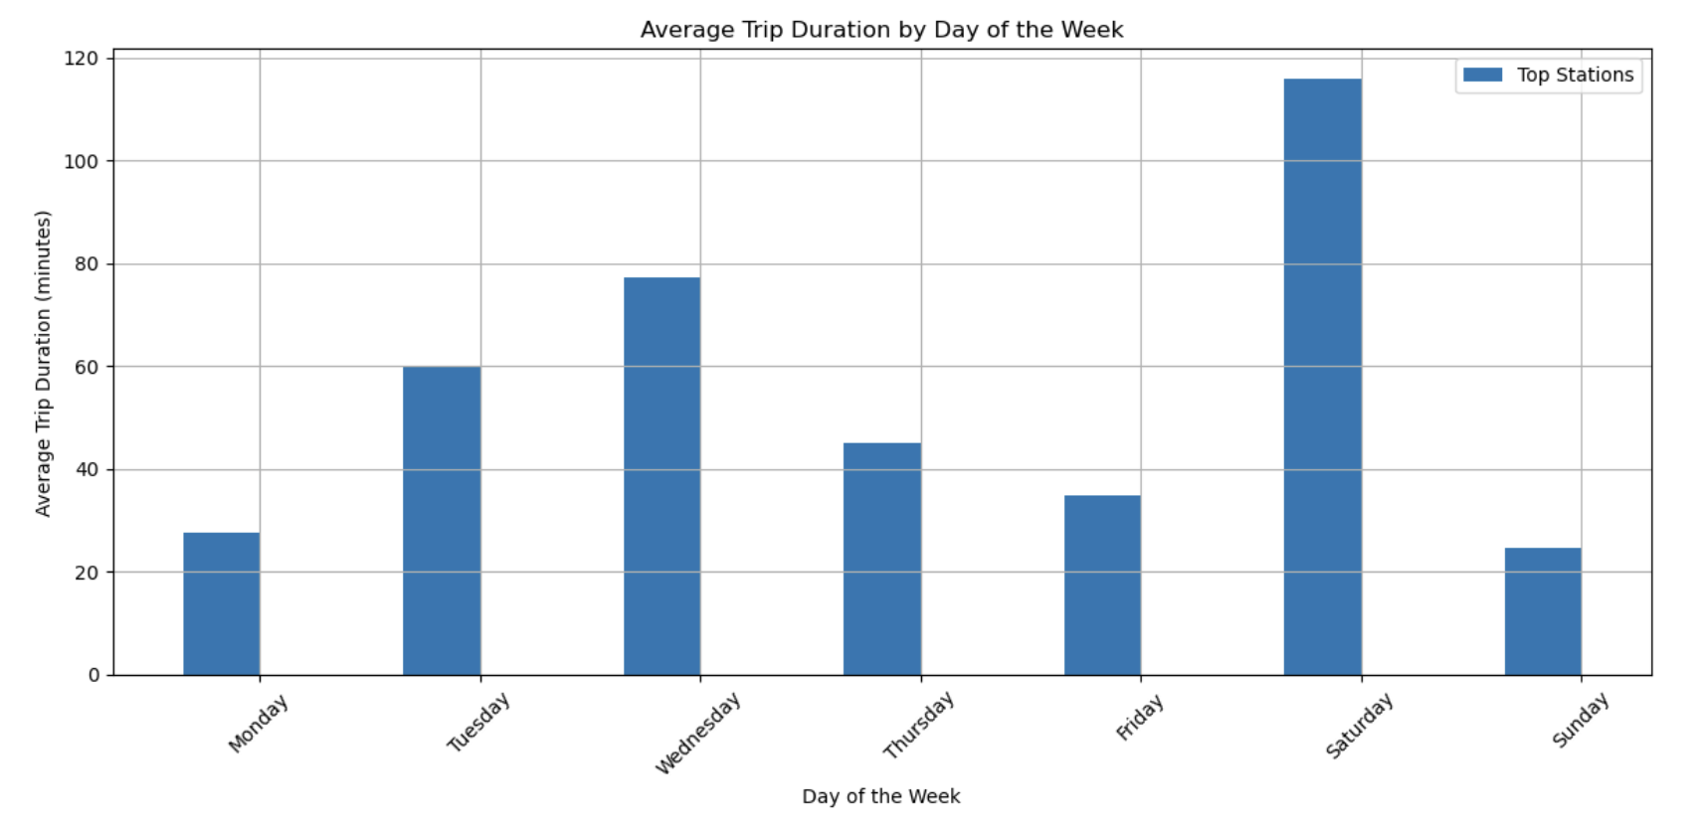
Day of the week?
When are the most used stations being accessed?

Slide 9
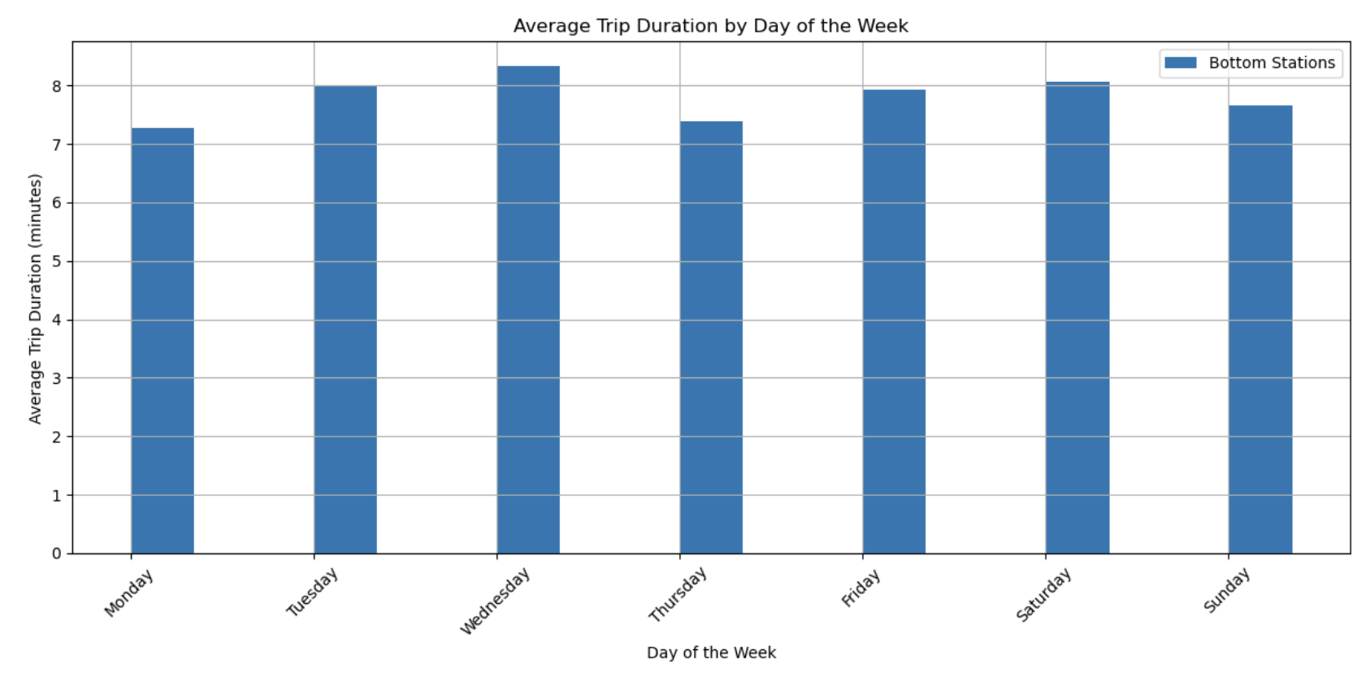
Day of the week?
When are the least used stations being accessed?

Slide 10
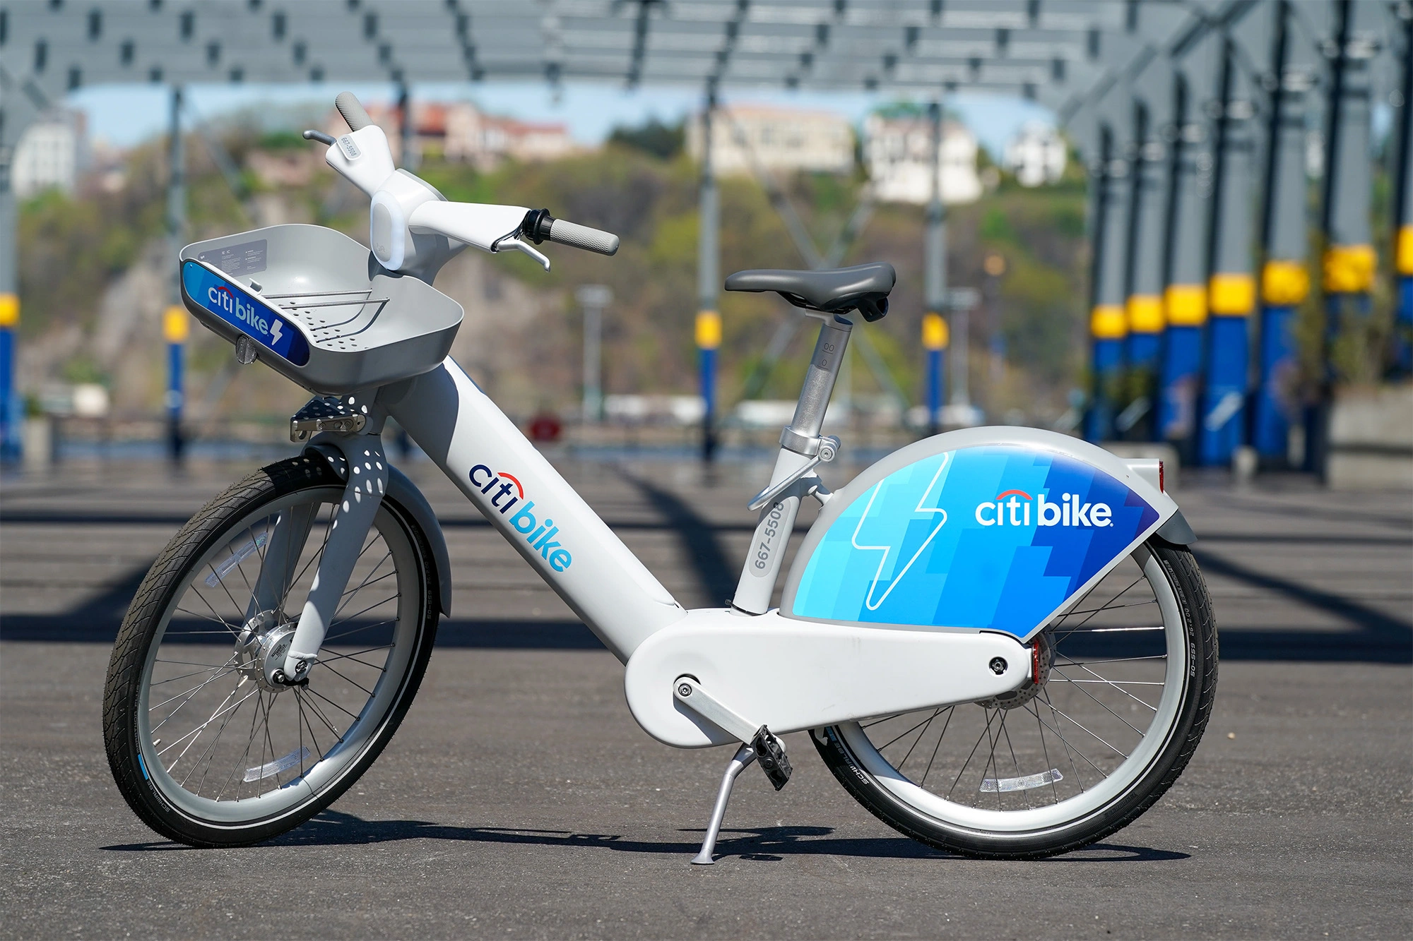
Next Steps:
Why Saturday?
Why 0-17 year olds?

Slide 11
Location of the Citi Bike stations are not as impactful when it comes to station usage

